Slide 1
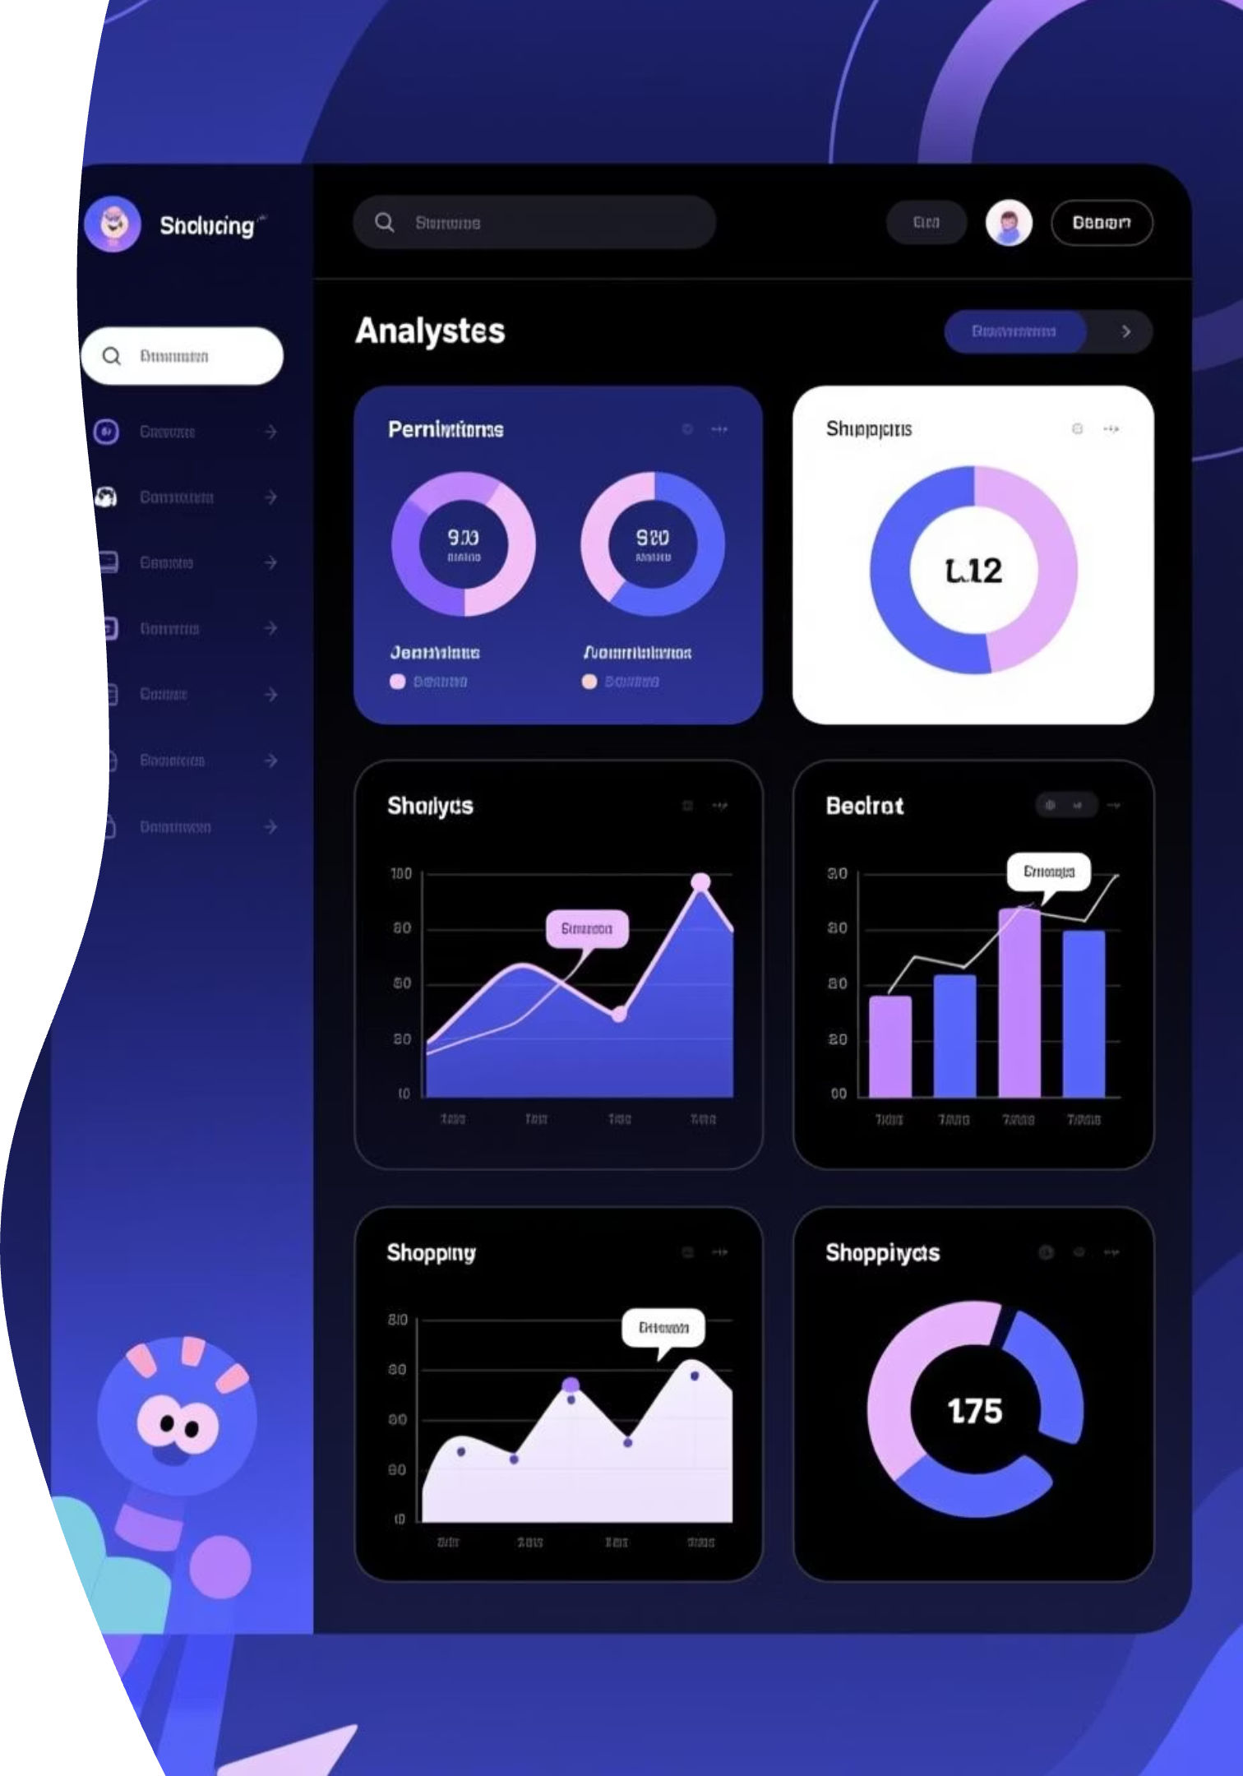
Customer Shopping Behavior Analysis
Uncovering insights from 3,900 purchases to guide strategic business decisions

Slide 2

Dataset Overview
3,900
18
4
Total Purchases
Data Points
Categories
Transactions analyzed
Features per transaction
Product segments
50
Locations
Geographic coverage
Comprehensive dataset covering demographics, purchase details, and shopping behavior patterns

Slide 3
Data Preparation & Engineering
01
02
03
Data Loading & Exploration
Missing Data Handling
Feature Engineering
Imported dataset, checked structure with df.info() and summary statistics
Imputed 37 missing Review Rating values using median by category
Created age_group bins and purchase_frequency_days columns
04
05
Data Standardization
Database Integration
Renamed columns to snake case, dropped redundant promo_code_used
Connected to PostgreSQL for advanced SQL analysis

Slide 4
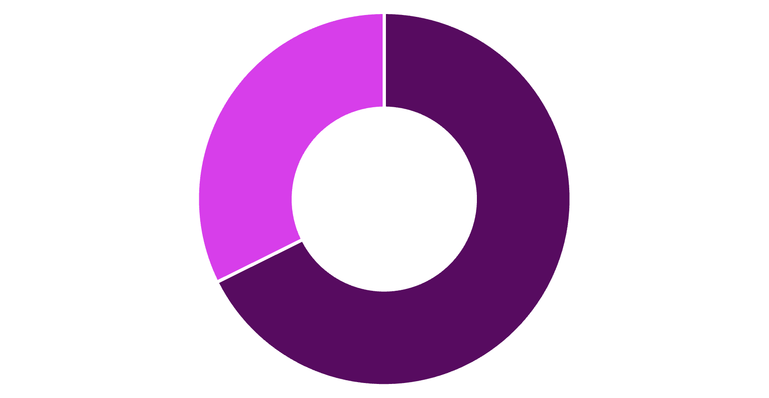
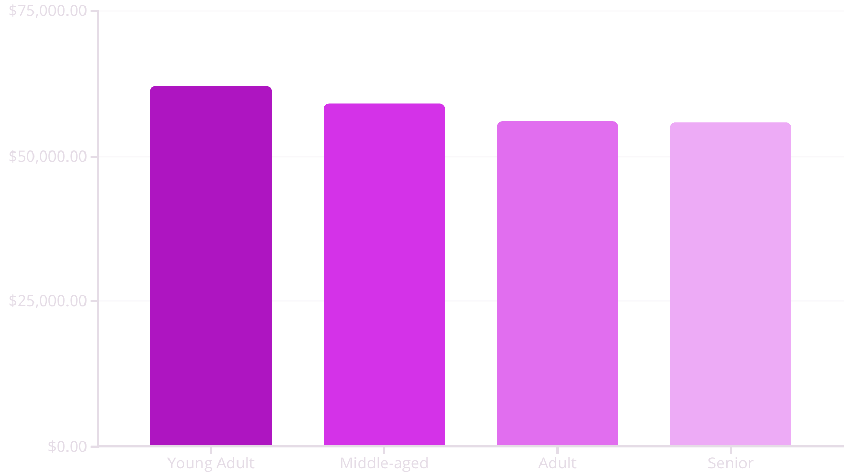
Revenue Insights
Gender Revenue Split
Revenue by Age Group
Male
Female
Male customers generate 68% of total revenue
Young adults lead revenue generation across all segments

Slide 5
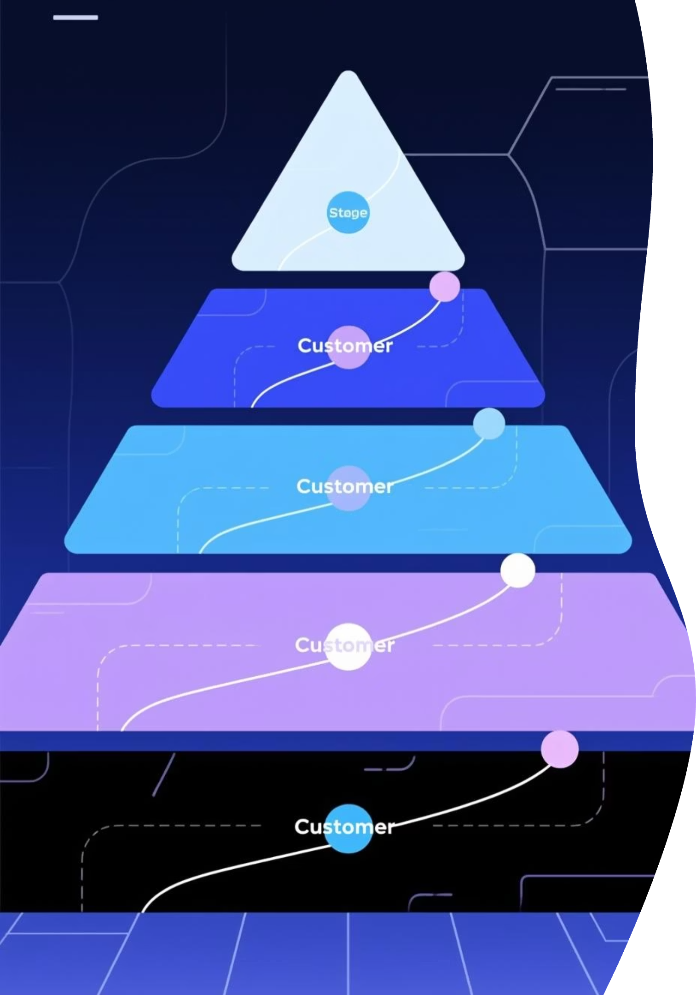

Customer Segmentation Analysis
Loyal Customers
Returning Buyers
3,116 customers
701 customers
Highest purchase frequency, core revenue drivers
Growing engagement, conversion opportunity
New Customers
83 customers
Fresh acquisition, nurture potential
Key Finding: 80% of customers are loyal, indicating strong retention but limited new customer acquisition

Slide 6
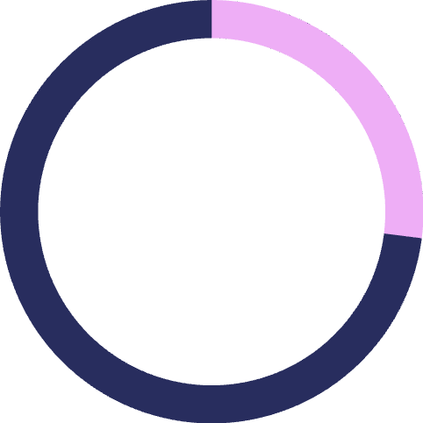


Subscription Impact
27%
Subscribers
1,053 customers
73%
Non-Subscribers
2,847 customers
Spending Comparison
Subscribers: $59.49 average spend
Non-subscribers: $59.87 average spend
Minimal difference in purchase behavior
Opportunity: Subscription benefits not driving higher spend—need stronger value proposition

Slide 7
Product Performance
Top Rated: Gloves
Sandals
Boots
3.86 average rating
3.84 average rating
3.82 average rating
Best Sellers by Category
Clothing
Accessories
Blouse (171), Pants (171), Shirt (169)
Jewelry (171), Sunglasses (161), Belt (161)
Footwear
Outerwear
Sandals (160), Shoes (150), Sneakers (145)
Jacket (163), Coat (161)

Slide 8


Discount Strategy Analysis
High-Value Discount Users
Discount-Dependent Products
839 customers used discounts but spent above average ($59.76)
50%
Hat
49.7%
Sneakers
49.1%
Coat
48.2%
Sweater
47.4%
Pants
Strategic Insight: Nearly 50% of purchases for certain products rely on discounts—review pricing strategy to protect margins

Slide 9
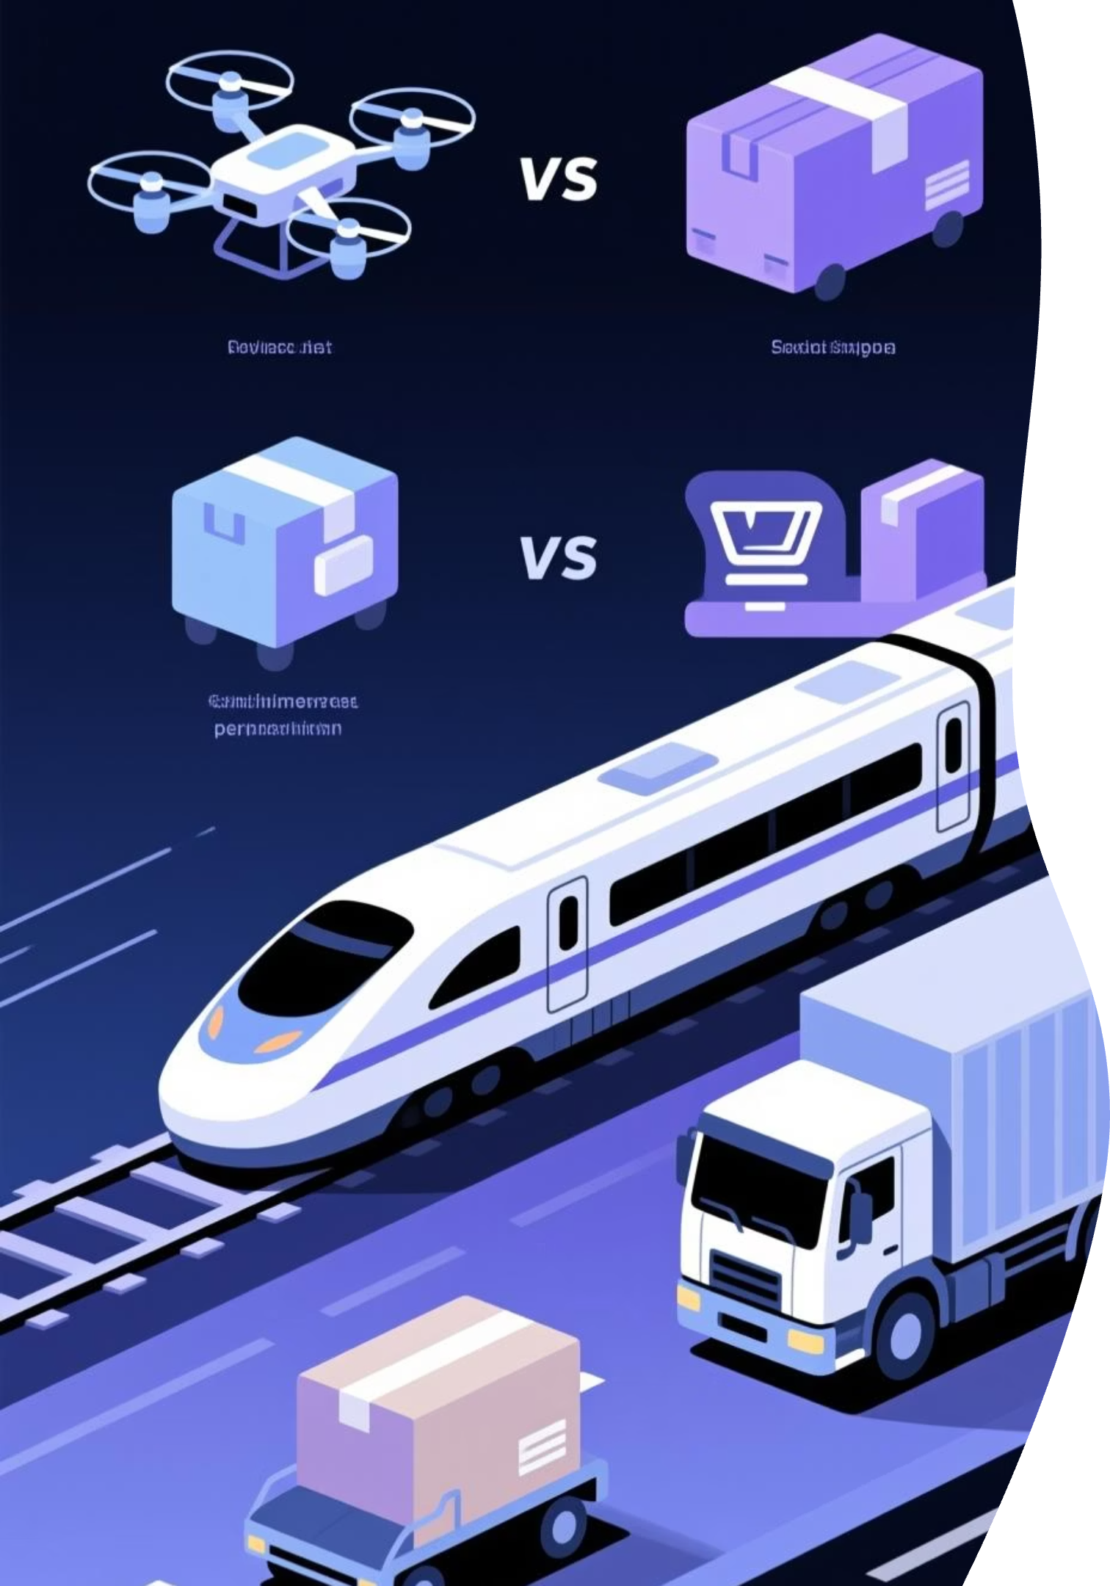

Shipping & Purchase Patterns
Express Shipping
$60.48 avg purchase
Higher-value orders
Standard Shipping
$58.46 avg purchase
Cost-conscious buyers
Repeat Buyer Behavior
Customers with 5+ purchases:
958 are subscribers
2,518 are non-subscribers
Opportunity to convert loyal non-subscribers

Slide 10




Strategic Recommendations
Boost Subscriptions
Promote exclusive benefits and rewards for subscribers
Loyalty Programs
Reward repeat buyers to increase retention
Review Discounts
Balance sales growth with margin protection
Product Positioning
Highlight top-rated items (Gloves, Sandals, Boots) in marketing campaigns
Targeted Marketing
Focus on high-revenue segments: Young Adults and express-shipping users

